Slide 1
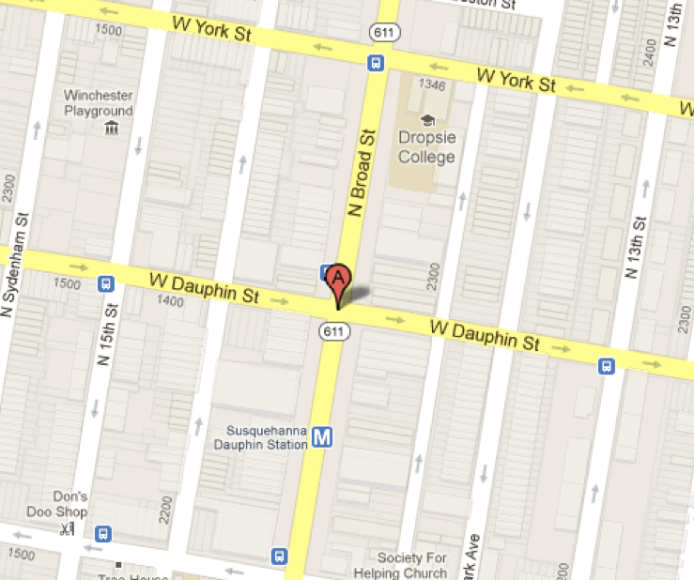
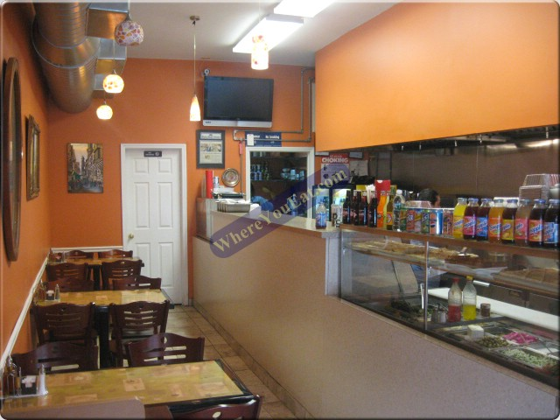
Grand Opening!
Coupon
Buy 1 Entrée
Get 1 Free
Offer Ends 3/20/13
Eat In Only!
Super Falafel, Inc.
2113 North 13th St, Philadelphia, PA 19122
Phone: 215-555-1212 / Fax: 215-555-1213
Order Online Today: http://caatech2012.weebly.com/super-falafel.html

